Slide 1
Experiments and simulations of 2SDR

Slide 2
Introduction
Dimension reduction and denoising plays an important role in cryo-EM processing
PCA is used in multivariate statistical analysis for cryo-EM in its early stage[1]
Variants like Steerable PCA[2] are designed specifically for particle images
Recently, deep leaning approach has been introduce for denoising particle images[3] or micrographs
Use denoising example to demonstrate the property and features of 2SDR
PCA
MPCA
2SDR

Slide 3
Dataset
Real data application
Particle images
70s Ribosome (Regular sample size, using regular desktop or notebook)
80s Ribosome (Large sample size, using server)
Movie files
Betagal (Small sample size)
Simulation data with different sample size and SNR
PCA model
2SDR model
Synthetic cryo-EM particle images with different SNR

Slide 4
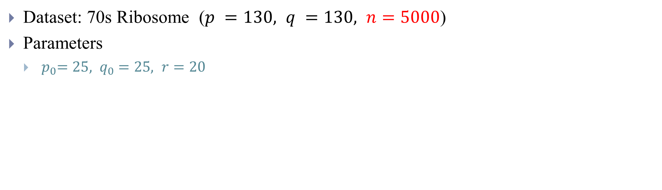
Real data application – Particle images
Dataset: 70s Ribosome ($p =130, q =130, n=5000$)
Parameters
${ p}_{0}=25, { q}_{0}=25, r=20$
Original
PCA
MPCA
2SDR

Slide 5
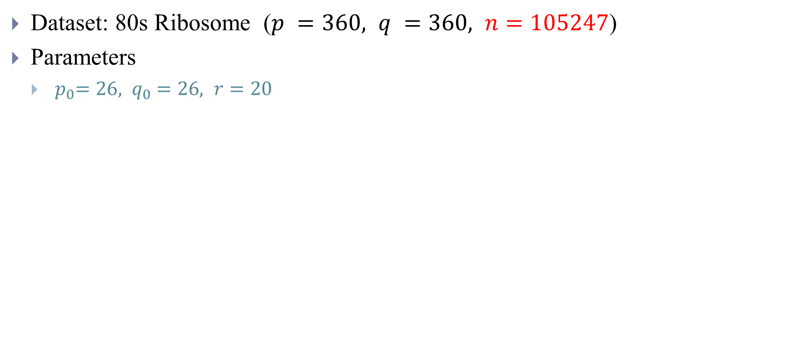
Real data application – Particle images
Dataset: 80s Ribosome ($p =360, q =360, n=105247$)
Parameters
${ p}_{0}=26, { q}_{0}=26, r=20$
Original
PCA
MPCA
2SDR

Slide 6
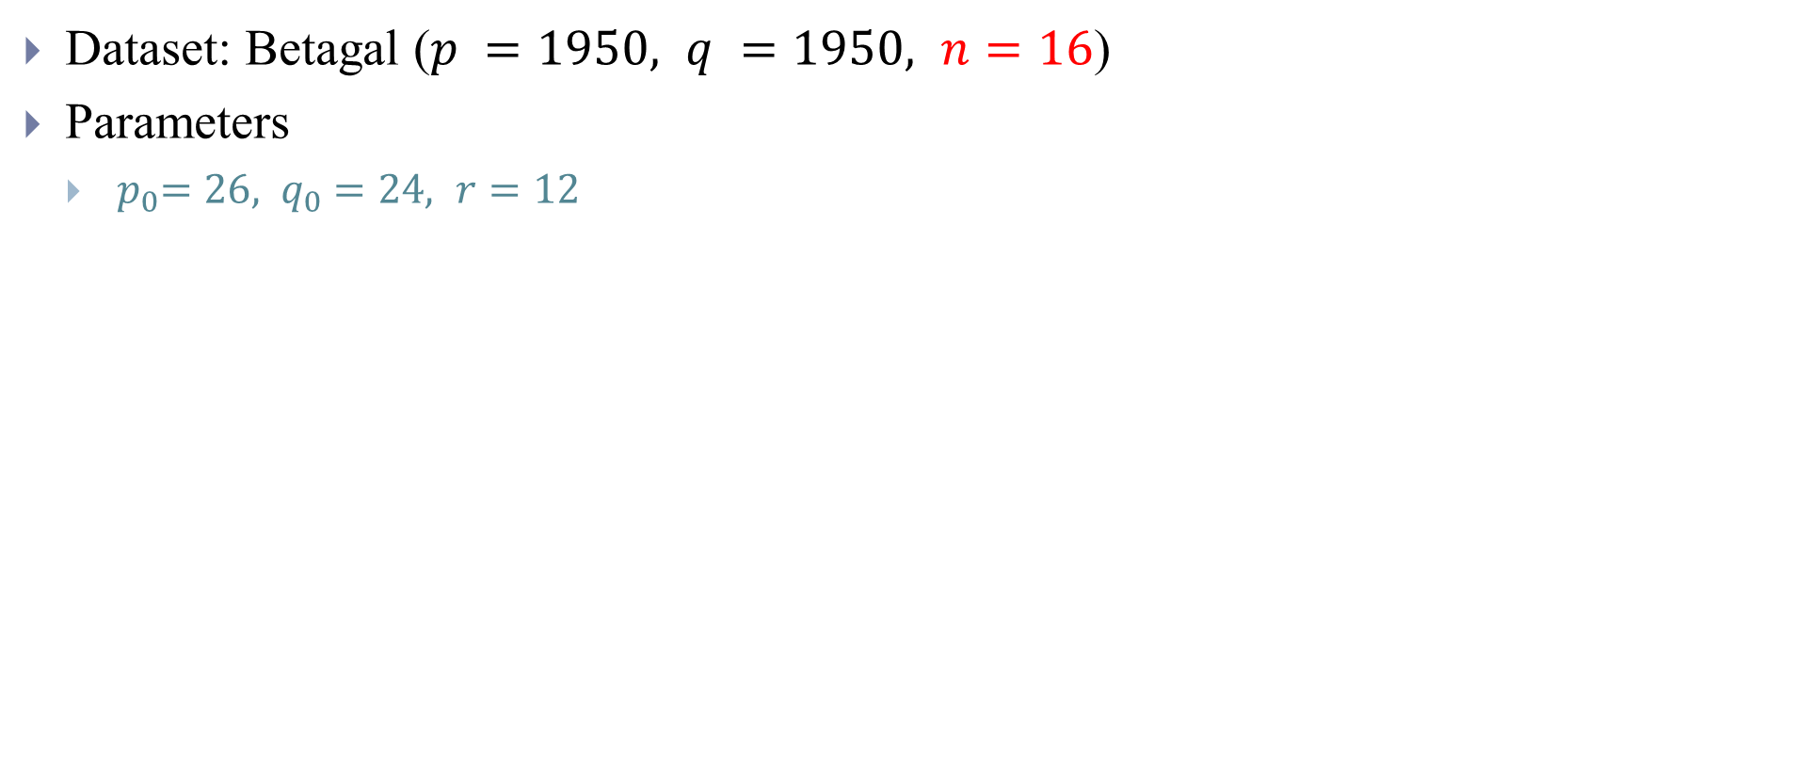
Real data application – Movie files
Dataset: Betagal ($p =1950, q =1950, n=16$)
Parameters
${ p}_{0}=26, { q}_{0}=24, r=12$
Contrast enhancement
PCA
MPCA
2SDR
Notes:
General方法

Slide 7

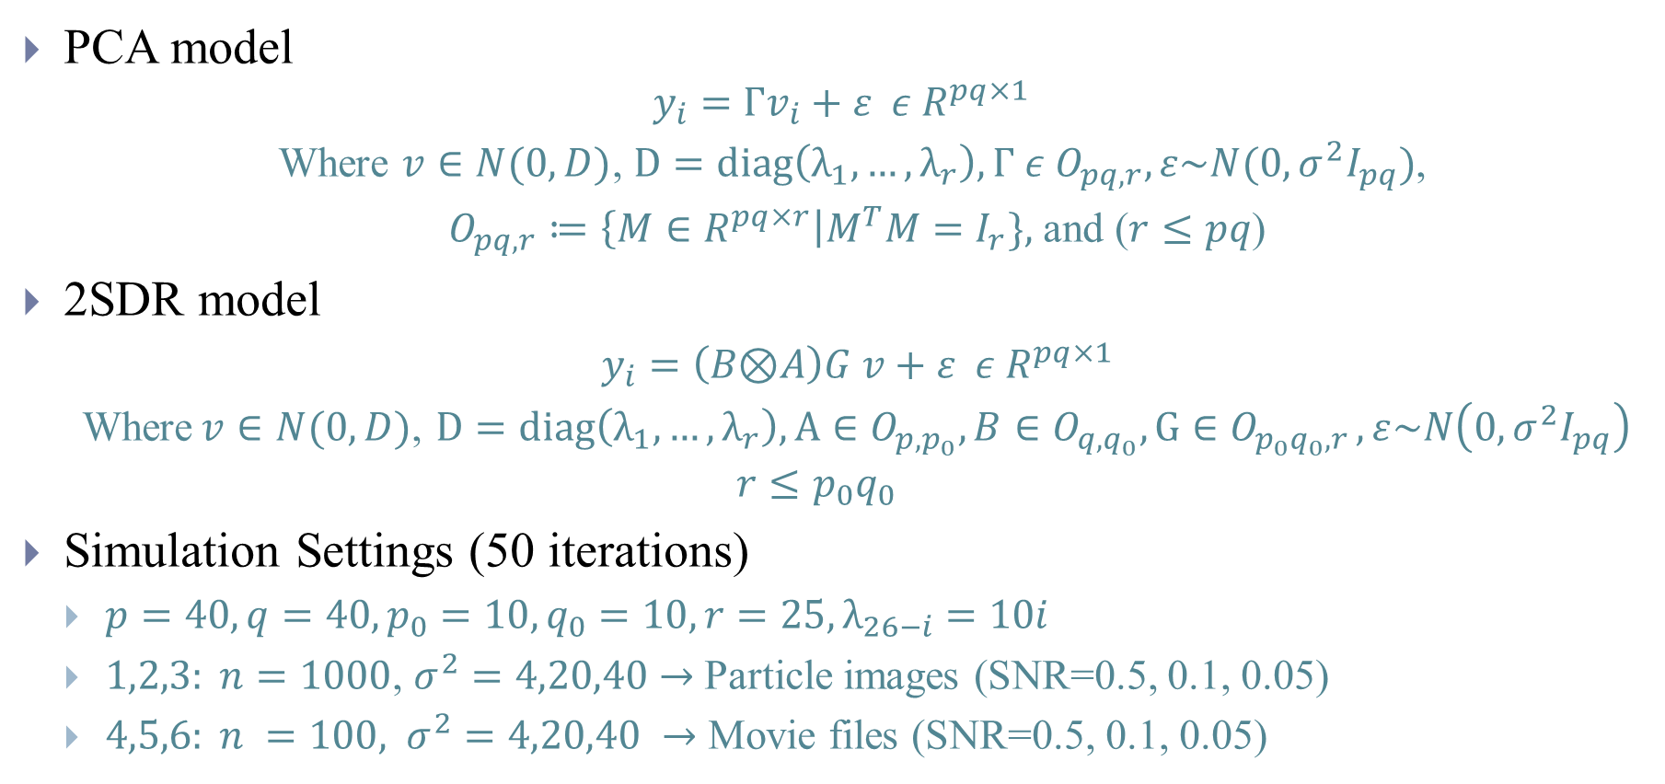
Simulations
$$SNR = \frac{var(Гv)}{var(ε)}$$
PCA model
$$y_{i}=Гv_{i}+ε ε{ R}^{pq×1}$$
Where $v∈N(0,D)$, $D=diag\left(λ_{1},…,λ_{r}\right), Г ε O_{pq,r},ε\sim N(0,σ^{2}I_{pq})$,
$O_{pq,r}≔\left\{M∈R^{pq×r}\right|M^{T}M=I_{r}\},$ and ($r≤pq$)
2SDR model
$y_{i}=\left(B\text{⊗}A\right)G v+ε ε{ R}^{pq×1}$
Where$v∈N(0,D)$, $D=diag\left(λ_{1},…,λ_{r}\right), A∈O_{p,p_{0}}, B∈O_{q,q_{0}},G∈O_{p_{0}q_{0},r },ε\sim N\left(0,σ^{2}I_{pq}\right)$
$$r≤p_{0}q_{0}$$
Simulation Settings (50 iterations)
$p=40, q=40,p_{0}=10,q_{0}=10, r=25,λ_{26−i}=10i$
$1,2,3: n=1000$, $σ^{2}=4,20,40$ $→$ Particle images (SNR=0.5, 0.1, 0.05)
$4,5,6: n =100,$ $σ^{2}=4,20,40$ $→$ Movie files (SNR=0.5, 0.1, 0.05)

Slide 8
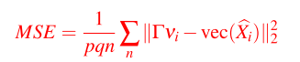
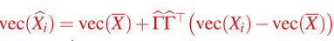
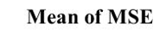
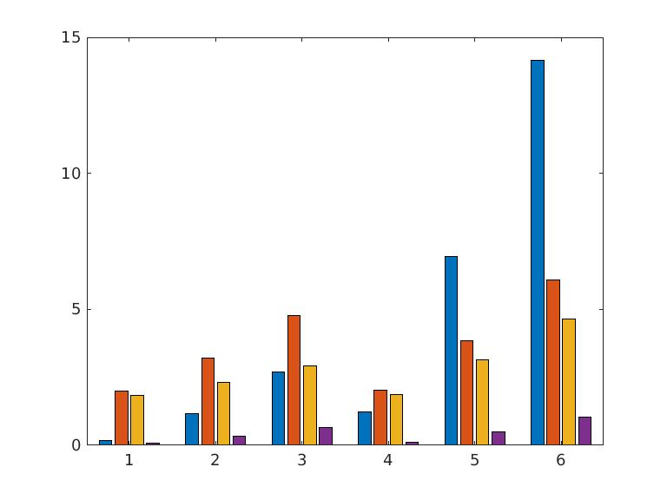
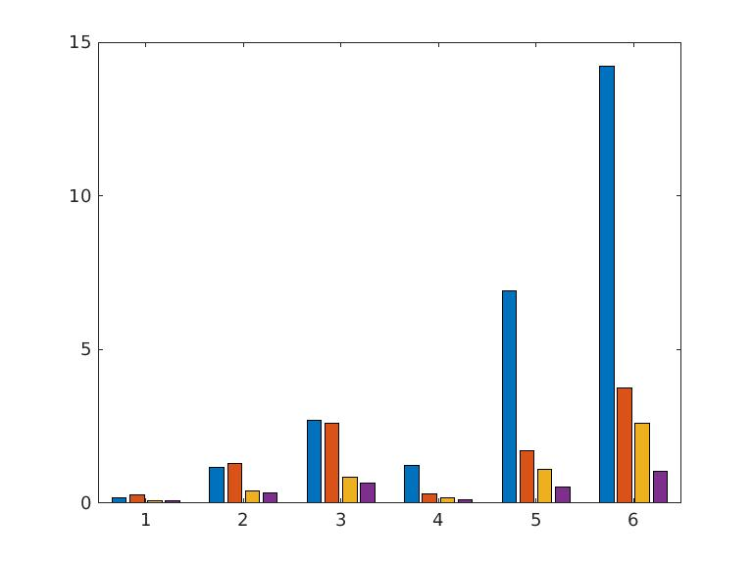
Simulations
PCA model
2SDR model

Slide 9
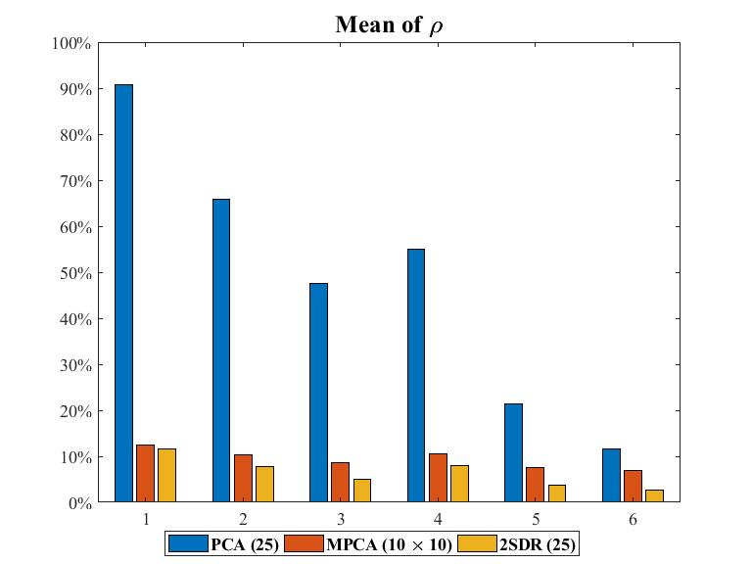
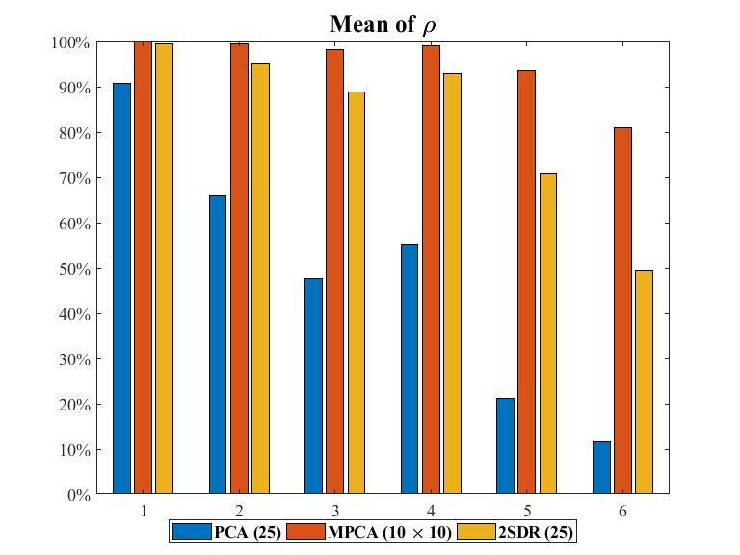
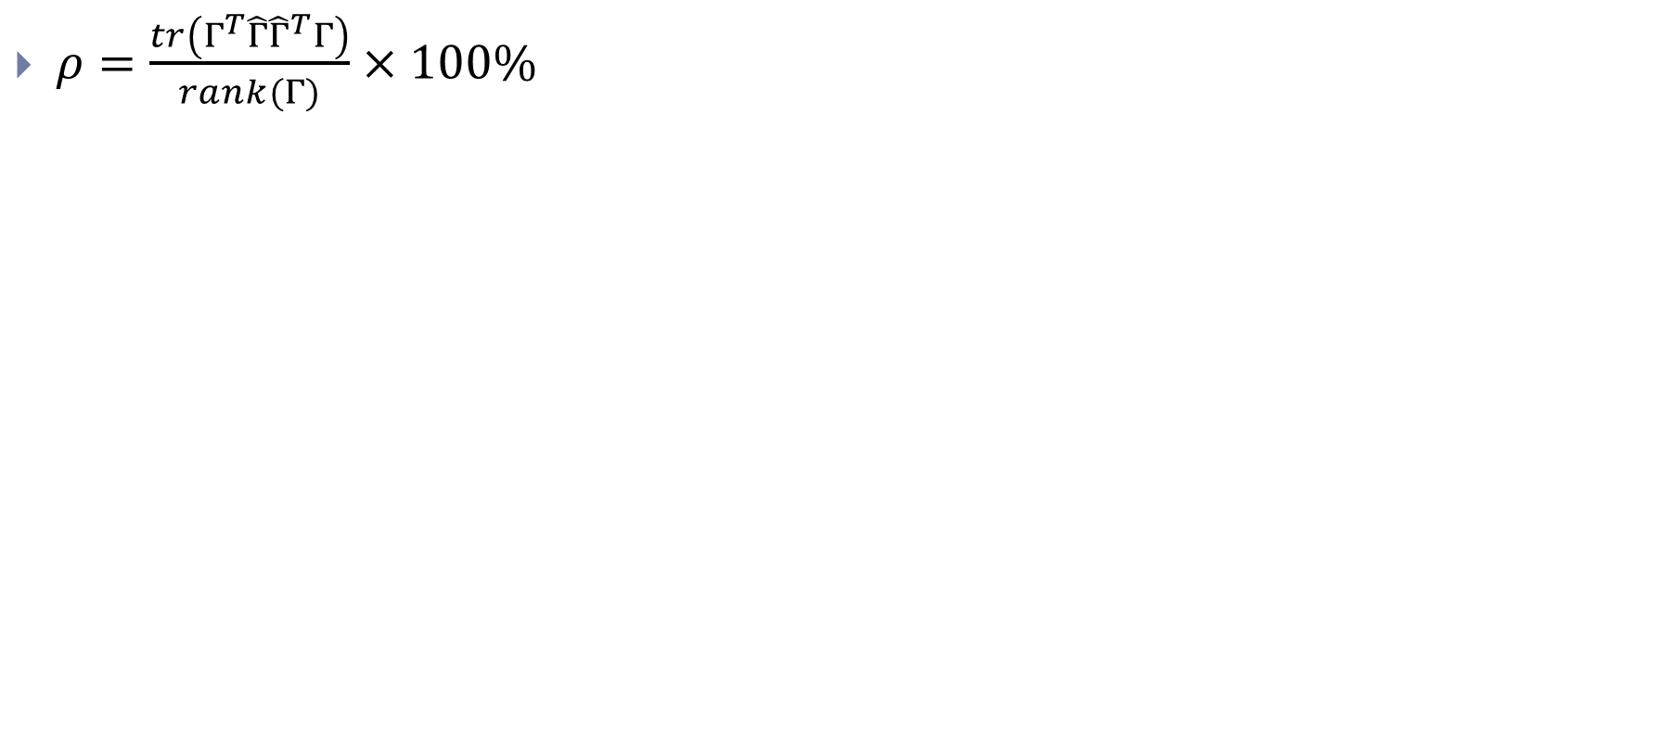

Simulations
$ρ=\frac{tr\left(Γ^{T}\hat{Γ}{\hat{Γ}}^{T}Γ\right)}{rank(Γ)}×100\%$
$$tr\left(Γ^{T}\hat{Γ}{\hat{Γ}}^{T}Γ\right)=tr({{(P}_{\hat{Γ}}Γ)}^{T}{(P}_{\hat{Γ}}Γ))$$
PCA model
2SDR model
Notes:
trace equals to sum of eigenvalues
https://math.stackexchange.com/questions/546155/proof-that-the-trace-of-a-matrix-is-the-sum-of-its-eigenvalues
How much variance is capture

Slide 10
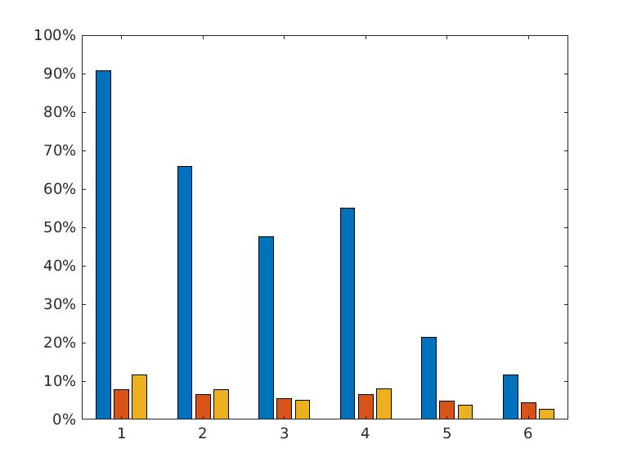
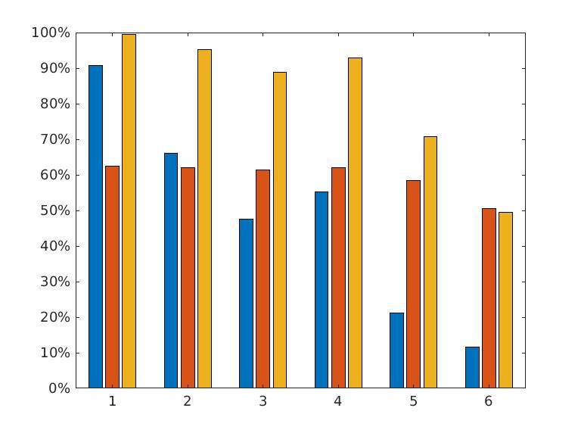

Simulations
$ρ=(\frac{tr\left(Γ^{T}\hat{Γ}{\hat{Γ}}^{T}Γ\right)}{rank(\hat{Γ})}+\frac{tr\left({\hat{Γ}}^{T}ΓΓ^{T}\hat{Γ}\right)}{rank(Γ)})/2×100\%$
PCA model
2SDR model

Slide 11
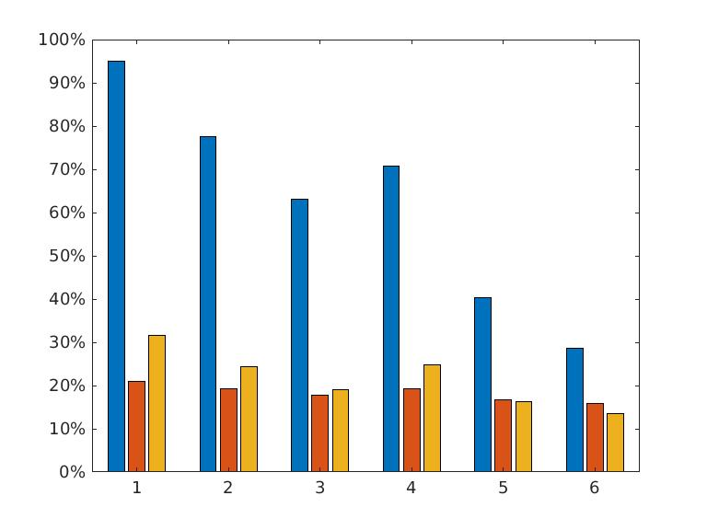
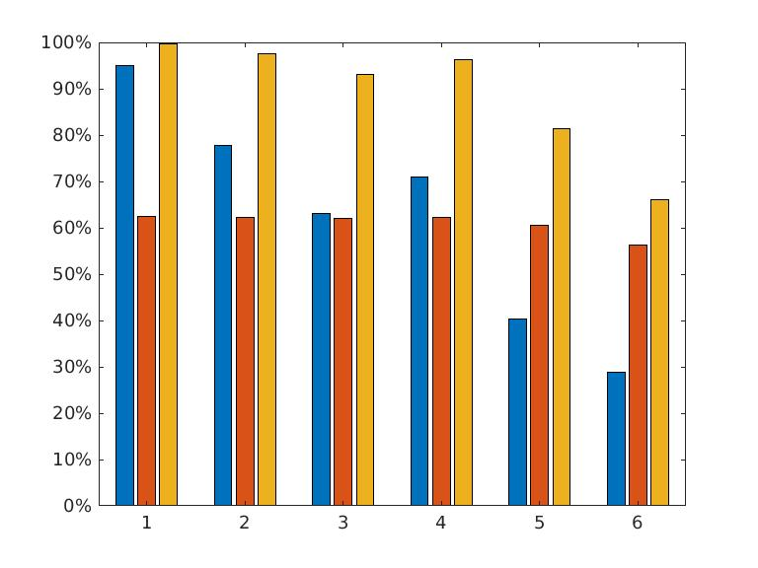

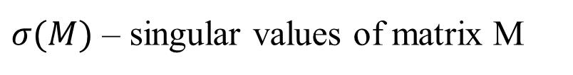
Simulations
$ρ=(\frac{\sum{σ\left({\hat{Γ}}^{T}Γ\right)}}{rank\left(\hat{Γ}\right)}+\frac{\sum{σ\left(Γ^{T}\hat{Γ}\right)}}{rank\left(Γ\right)}))/2×100\%$
$σ(M)$ – singular values of matrix M
PCA model
2SDR model

Slide 12
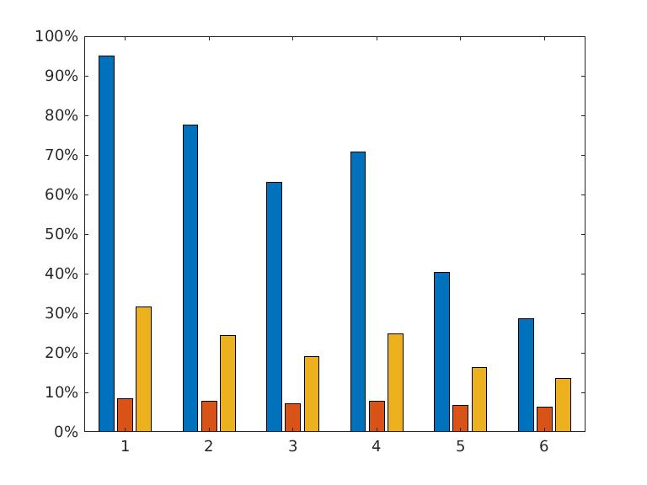
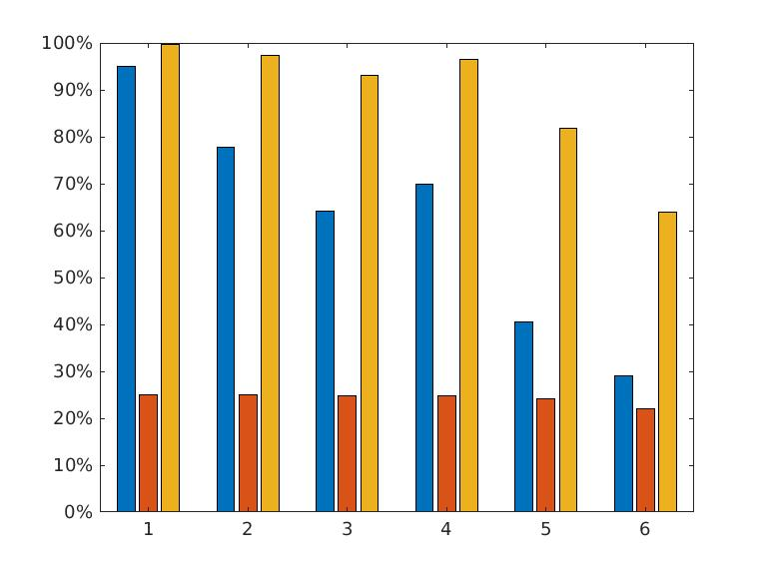

Simulations
$ρ=(\frac{\sum{σ\left({\hat{Γ}}^{T}Γ\right)}}{max⁡(rank\left(\hat{Γ}\right), rank\left(Γ\right))})/2×100\%$
PCA model
2SDR model

Slide 13
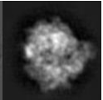
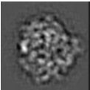
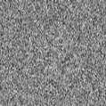
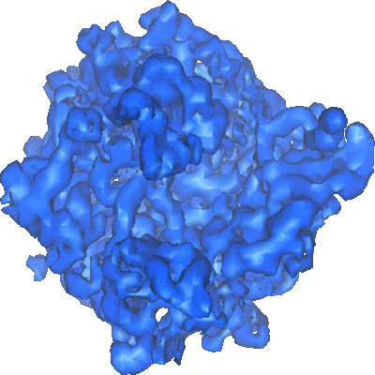
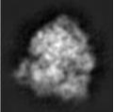
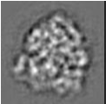
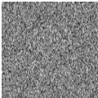
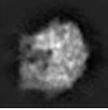
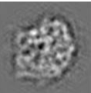
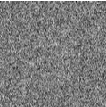
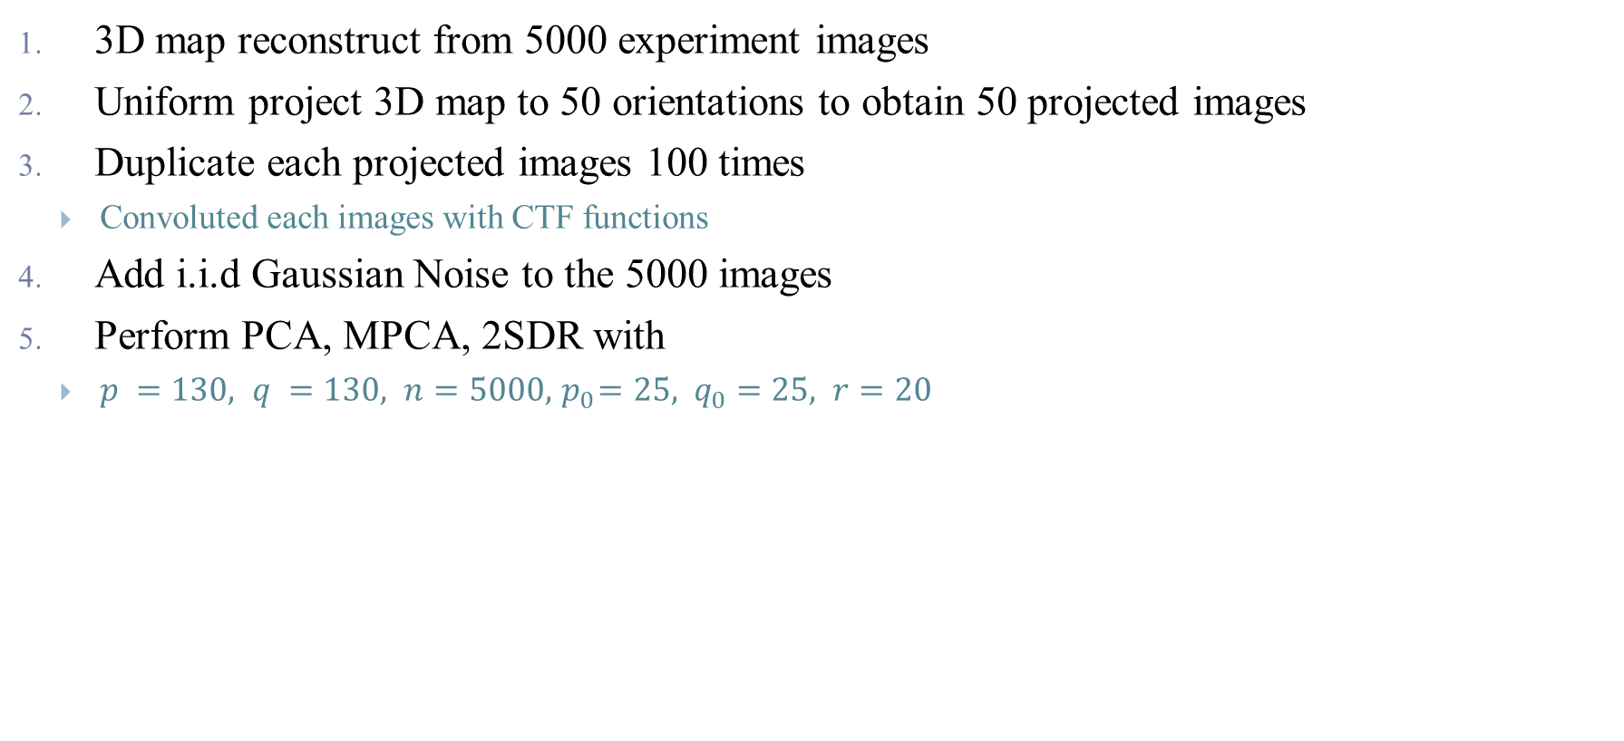
Synthetic Data
3D map reconstruct from 5000 experiment images
Uniform project 3D map to 50 orientations to obtain 50 projected images
Duplicate each projected images 100 times
Convoluted each images with CTF functions
Add i.i.d Gaussian Noise to the 5000 images
Perform PCA, MPCA, 2SDR with
$p =130, q =130, n=5000, { p}_{0}=25, { q}_{0}=25, r=20$
Notes:
with defocus ranging from 1.5um-2um, voltage 300ev, astigmatism angle 0.2-1.4 radian, Cs=2

Slide 14
Synthetic Data – Without CTF
Original
Noisy
PCA
MPCA
2SDR
SNR
SNR=0.5
SNR=0.1
SNR=0.05

Slide 15
Synthetic Data – With CTF
Original
Noisy
PCA
MPCA
2SDR
SNR
SNR=0.1
SNR=0.05
SNR=0.01

Slide 16
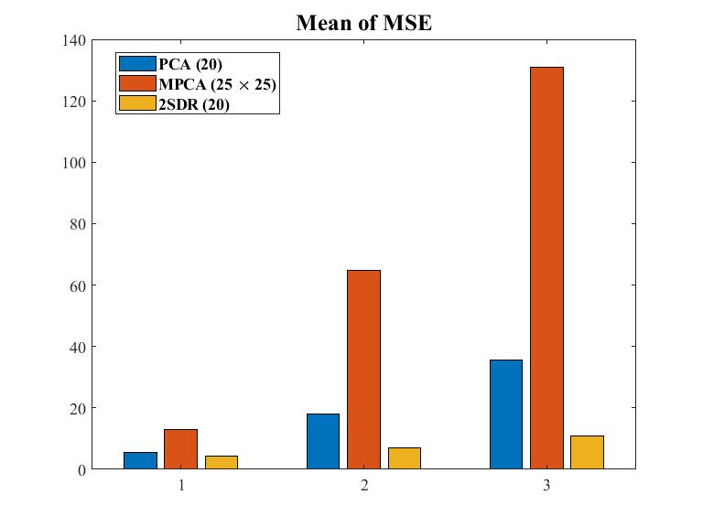
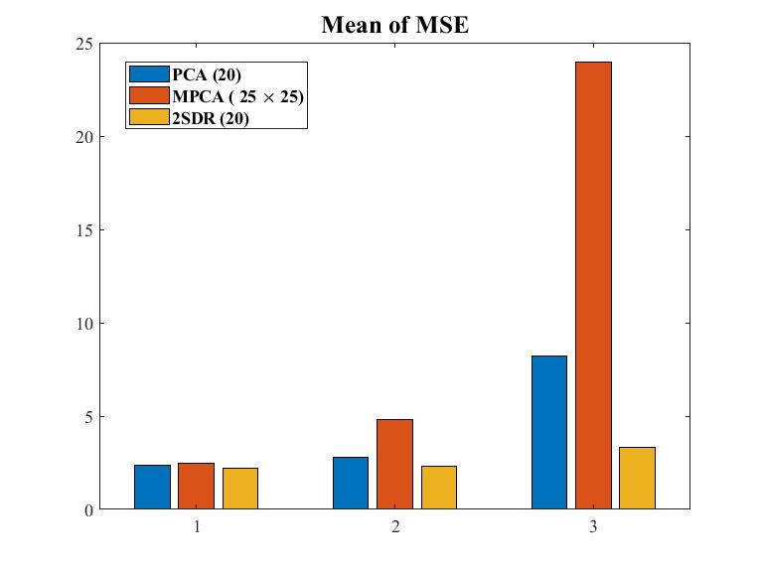
Synthetic Data
Without CTF
With CTF

Slide 17
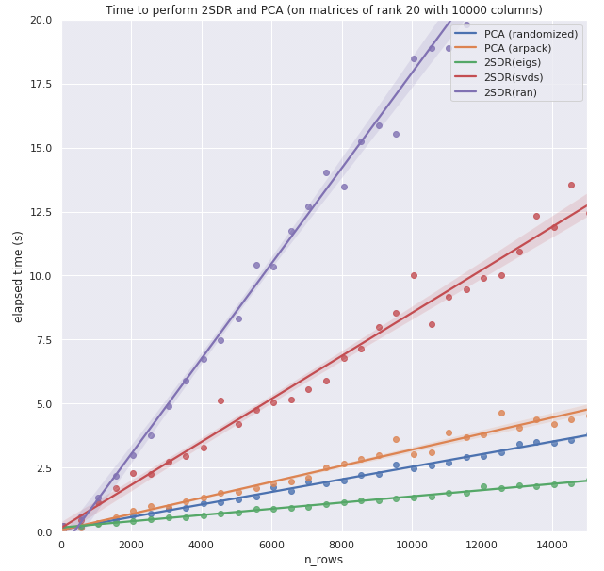
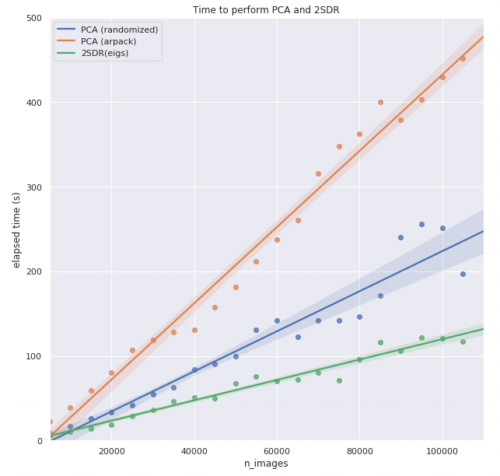
Short Summary
2SDR has several advantage
Performs better than PCA when SNR is low or sample size is small
Computation cost is less than PCA
Last time, our implementation is about 2.x faster than PCA

Slide 18
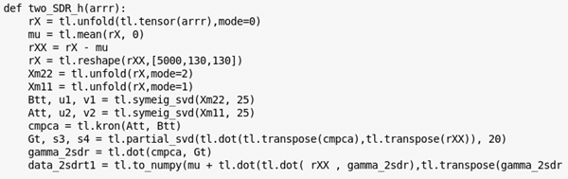
Speed revisit – Enable GPU
Tensorly[5] provides interface to
NumPy
Pytorch
Tensorflow
Mxnet
CuPy
Memory limitation
 | Pytorch | Tensorflow | Mxnet | CuPy
dot | matmul | tensordot | dot | dot
mean | mean | mean | mean | mean
transpose | permute | transpose | transpose | transpose
reshape | reshape | reshape | reshape | reshape
partial_svd | svd | svd | N/A | svd
symeig_svd | symeig | N/A | linalg.syevd | N/A
Notes:
Finally, the fact that items are stored contiguously in memory allows NumPy to take advantage of vectorized instructions of modern CPUs, such as Intel's SSE and AVX, AMD's XOP, and so on.
For example, multiple consecutive floating point numbers can be loaded in 128, 256, or 512 bits registers for vectorized arithmetical computations implemented as CPU instructions.
Additionally, NumPy can be linked to highly optimized linear algebra libraries such as BLAS and LAPACK through ATLAS or the Intel Math Kernel Library (MKL). A few specific matrix computations may also be multithreaded, taking advantage of the power of modern multicore processors.

Slide 19
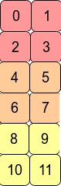
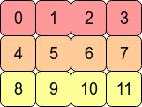
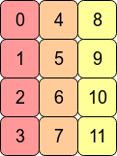
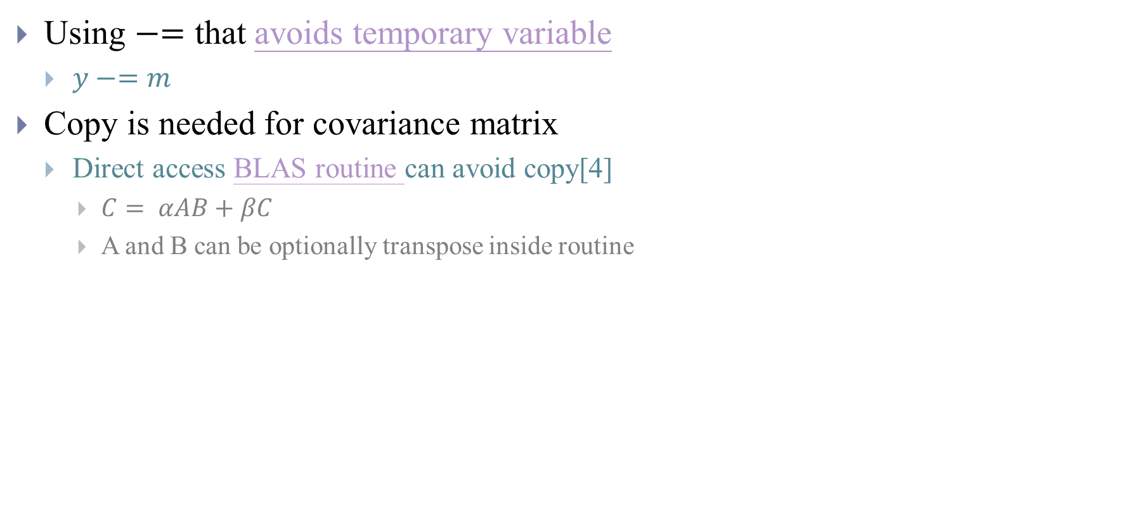
Speed revisit – Avoid copy
Reshape
Using $−=$ that avoids temporary variable
$y−=m$
Copy is needed for covariance matrix
Direct access BLAS routine can avoid copy[4]
$C= αAB+βC$
A and B can be optionally transpose inside routine
C contiguous (Row Major)
Data Types
A, B, C, α, β | Subroutine
float real | SGEMM
double real | DGEMM
float complex | CGEMM
double complex | ZGEMM
Fortran contiguous
Copy
Notes:
Reshape(6,2) return view
Constant stride is allowed
https://eli.thegreenplace.net/2015/memory-layout-of-multi-dimensional-arrays layout
Among the programming languages still popular today, Fortran was definitely one of the pioneers. And Fortran (which is still very important for scientific computing) uses column-major layout. I read somewhere that the reason for this is that column vectors are more commonly used and considered "canonical" in linear algebra computations. Personally I don't buy this, but you can make your own judgement.

Slide 20
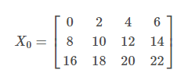
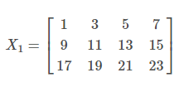
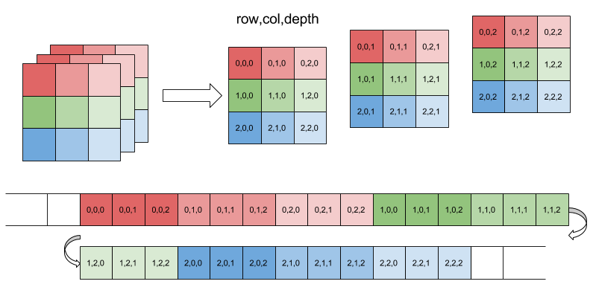
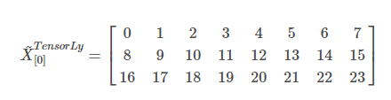
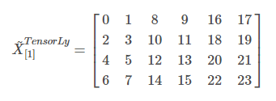
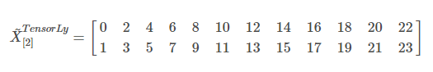
Speed revisit – Avoid copy
Copy is needed when we unfold along mode 1
Notes:
3*4*2
A slew of modern languages follow Fortran's lead - Matlab, R, Julia, to name a few. One of the strongest reasons for this is that they want to use LAPACK - a fast Fortran library for linear algebra, so using Fortran's layout makes sense.
On the other hand, C and C++ use row-major layout. Following their example are a few other popular languages such as Python, Pascal and Mathematica.

Slide 21
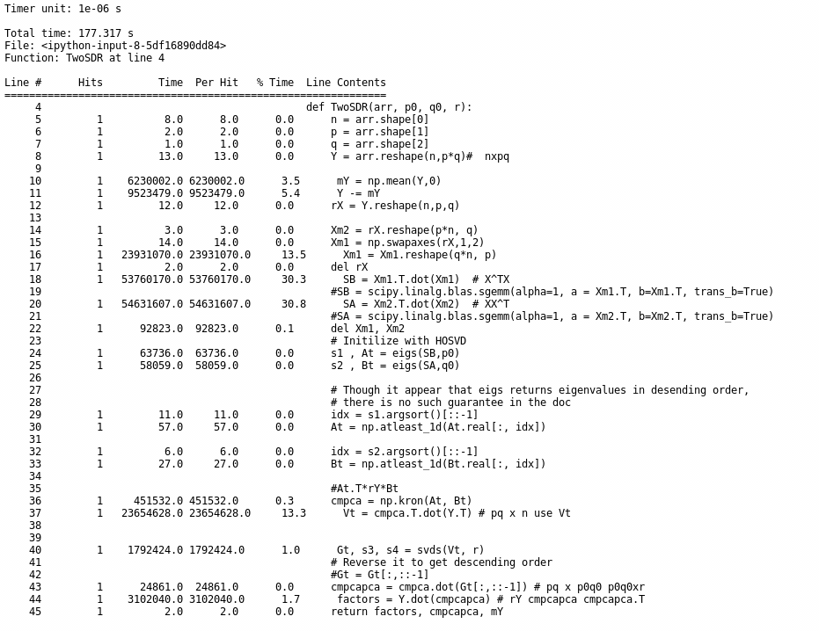
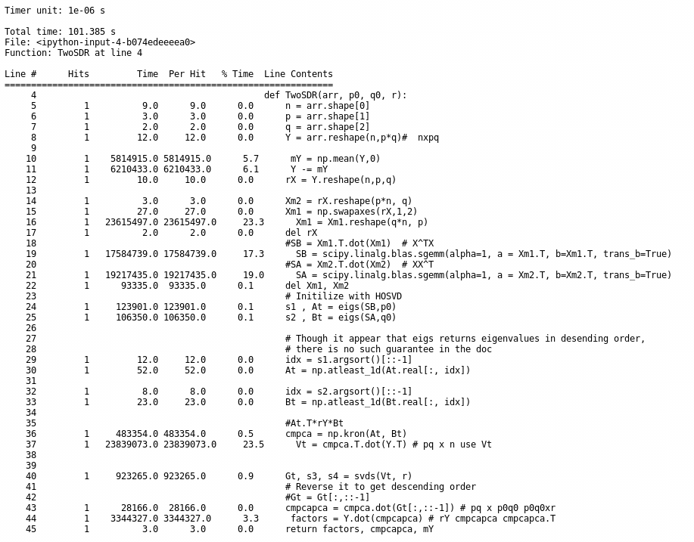
Speed revisit – Avoid copy

Slide 22
Speed revisit
70S Ribosome sec
PCA (Randomized SVD) | 2.45
2SDR(MPCA) - CPU | 3.58
2SDR(MPCA) - GPU | 1.78
2SDR(HOSVD)- CPU | 1.31
2SDR(HOSVD)- GPU | 0.72
80S Ribosome sec
PCA (Randomized SVD) | 459.54
2SDR(MPCA) | 270.52
2SDR(MPCA)- avoid copy | 226.83
2SDR(HOSVD) | 177.31
2SDR(HOSVD)- avoid copy | 101.38

Slide 23
Conclusion
2SDR has several advantage
Performs better than PCA when SNR is low or sample size is small
Computation cost is less than PCA
General tool for image dataset in contrast to
Steerable PCA
Deep learning method
2SDR (More efficient and better in some aspect)
HOSVD + RPCA
PCA + t-SNE
FFT + PCA

Slide 24
References
[1] Afanasyev, Pavel, et al. "Single-particle cryo-EM using alignment by classification (ABC): the structure of Lumbricus terrestris haemoglobin." IUCrJ 4.5 (2017): 678-694.
[2] C. Ponce, A. Singer, Computing Steerable Principal Components of a Large Set of Images and their Rotations, IEEE Transactions on Image Processing, 20 (11), pp. 3051-3062 (2011). PMID: 21536533 [PubMed - indexed for MEDLINE] PMCID: PMC3719433.
[3] Su, Min, et al. "Generative adversarial networks as a tool to recover structural information from cryo-electron microscopy data." BioRxiv (2018): 256792.
[4] https://scipy.github.io/old-wiki/pages/PerformanceTips
[5] Jean Kossaifi, Yannis Panagakis, Anima Anandkumar and Maja Pantic, TensorLy: Tensor Learning in Python, Journal of Machine Learning Research (JMLR), 2019, volume 20, number 26.

Slide 25
Appendix

Slide 26
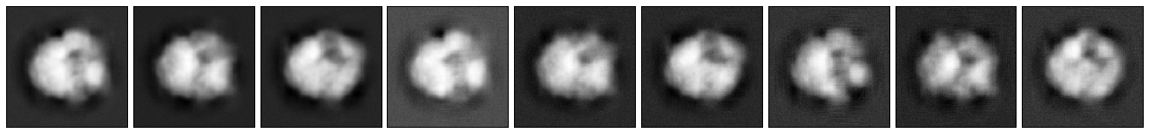
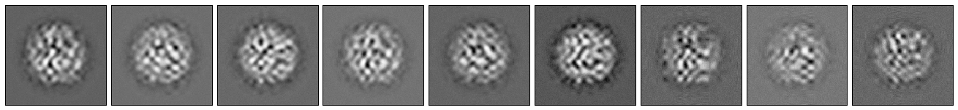
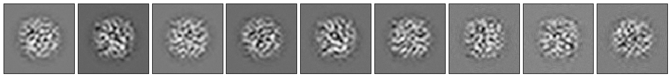




Different $p_{0}, q_{0}$
$5×$5
$5×$5
$$10×10$$

Slide 27


2SDR on 70S Ribosome

Slide 28

PCA on 80S Ribosome

Slide 29


























2SDR vs PCA
Solving eigenvectors of covariance matrix with size $m×m$ is $O(m^{2}r)$
$$HOSVD$$
$$MPCA$$
$\frac{1}{n}\sum_{i=1}^{n}{(X_{i}−\overline{X})}{(X_{i}−\overline{X})}^{T}$
(size: $p×p$)
$\frac{1}{n}\sum_{i=1}^{n}{(X_{i}−\overline{X})}\hat{B}{\hat{B}}^{T}{(X_{i}−\overline{X})}^{T}$
(size: $p×p$)
$$\frac{1}{n}\sum_{i=1}^{n}{{\hat{V}}_{i}{{\hat{V}}_{i}}^{T}}$$
$${\hat{V}}_{i}=vec\left({\hat{U}}_{i}\right)$$
(size: $p_{0}q_{0}×p_{0}q_{0}$)
Assuming
$p=q=300$
$$p_{0}=q_{0}=25$$
$$r =20$$
$\frac{1}{n}\sum_{i=1}^{n}{{(X_{i}−\overline{X})}^{T}}\hat{A}{\hat{A}}^{T}(X_{i}−\overline{X})$
(size: $q×q$)
$\frac{1}{n}\sum_{i=1}^{n}{{(X_{i}−\overline{X})}^{T}}(X_{i}−\overline{X})$
(size: $q×q$)
$$q$$
$$2SDR$$
$$p$$
$$q_{0}$$
$$p_{0}$$
$$O({10}^{6})$$
$$\hat{A}$$
$$\hat{B}$$
$$\hat{G}$$
$$\hat{Г}$$
$$q$$
PCA
$$p$$
$$\frac{1}{n}\sum_{i=1}^{n}{(y_{i}−\overline{y}){(y_{i}−\overline{y})}^{T}}$$
(size: $pq×pq$)
$$O({10}^{11})$$

Slide 30
Implementation Packages
Numerical Packages
ARPACK (Sparse matrix)
LAPACK (Dense matrix)
BLAS (OpenBLAS, MKL)
cuBLAS
Package | Method | Routine | Order
NumPy | svd | LAPACK | Descending
NumPy | eig | LAPACK | No order
SciPy | svds | ARPACK | Ascending
SciPy | eigs | ARPACK | Descending
Scikit-learn | PCA | svd/svds/eigs
cuML | TruncatedSVD | cuBLAS | No order
Notes:
if the input data is larger than 500x500 and the number of components to extract is lower than 80% of the smallest dimension of the data, then the more efficient ‘randomized’ method is enabled.

Slide 31
Tensor tools
Python
Tensorly
Matlab
Tensortoolbox
Tensorlab
R
rTensor
Notes:
http://jeankossaifi.com/blog/unfolding.html

